Slide 1
React and Redux Developer

Slide 2
Introduction to Redux

Slide 3
Install and set up React
- create-react-app tool
Build a React App
- Build blogger app
- Demonstrate component lifecycle
- Manage state

Slide 4

By the end of this lesson, you will be able to:
Discuss the need for Redux
Install and setup Redux
Explain the fundamentals of Redux
Illustrate how Redux performs state management in React apps

Slide 5
Introduction to Redux

Slide 6
Introduction to Redux
Redux is a JavaScript library used to manage an application’s front-end state.
Is created by Dan Abramov
Is inspired by the Flux architecture
Aims to make state management in an app more predictable and manageable
Is mostly used with React but can be used with any view library
Notes:
Redux is s a predictable state container for JavaScript apps.
Abramov started writing the first Redux implementation while preparing for a conference talk at React Europe on hot reloading.
Redux improves predictability:
Data is consolidated to a centralized location, i.e., the store.
Components require access for writing or updating data in the store.
Updating the store is governed by strict rules.
Redux believes in unidirectional data flow.
Data only flows one way through the application.
It helps you write applications that behave consistently, run in different environments (client, server, and native), and are easy to test.
Flux is an architectural pattern which enforces the uni-directional data flow. It controls derived data and enables communication between multiple Components using a central Store which has authority for all data. Any update in data throughout the application must occur here only. Flux provides stability to the application and reduces run-time errors.
Redux is mostly used with React but it can be used with any view library like Angular.

Slide 7
Introduction to Redux
Provides a great developer experience: live code editing and a time traveling debugger
Weighs 2KB including dependencies
Keeps the state of your application in a store
Lets each Component access any state that it needs from the store
Benefits :
Shared state
Caching
Notes:
It is lightweight at 2KB (including dependencies), so you don’t have to worry about it making your application’s asset size bigger.
With Redux, the state of your application is kept in a store and each Component can access any state that it needs from this store.
Shared state : share same piece of state with 2 or more Components
Caching : API calls or expensive operations, better user experience

Slide 8
Why Redux
Redux makes it easier to manage a shared state.
Redux gives clear code, easy access of state, and easy state transfer.
In React, a state has to live in the parent Component to share data among siblings.
Redux simplifies sharing state among siblings.
Notes:
Managing states shared across Components is difficult.
In React, to share data among siblings, a state has to live in the parent Component.
Most libraries like React are built with a way for Components to internally manage their state. It works well for applications with few Components but as the application grows bigger, managing states shared across Components becomes difficult.
In an app where data is shared among Components, it gets confusing to actually know where a state should live. Ideally, the data in a Component should live in just one Component. Thus sharing data among sibling Components becomes difficult.
For instance, in React, to share data among siblings, a state has to live in the parent Component. A method for updating this state is provided by this parent Component and passed as props to these sibling Components

Slide 9
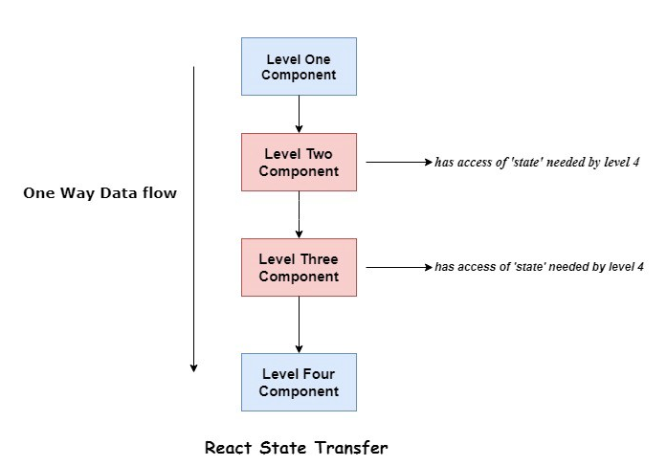
Why Redux
The diagram represents a state in the first-level Component being passed down to the fourth-level Component.
A level is equivalent to a single parent-child relationship.
Notes:
React would pass down the data from first level Component to second level Component and then to the third level Component and then finally to the fourth level Component. This is not a good approach as the data or state is passed to the 2nd and 3rd level Component(which doesn’t require that particular state).

Slide 10
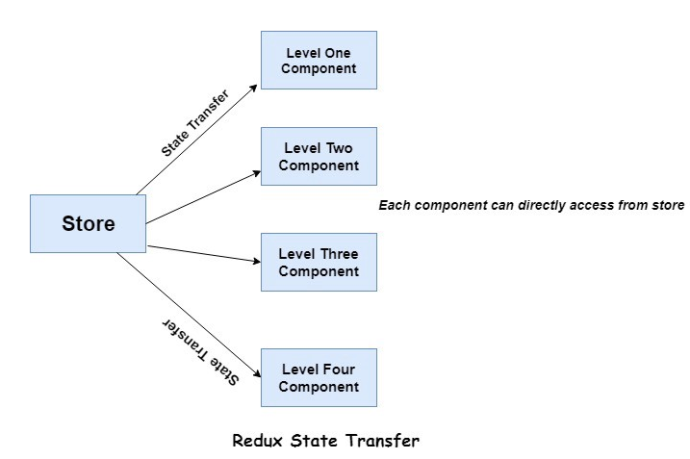
Why Redux
In Redux, we stash all the state in a single place called store.
Notes:
All the state is stashed in store and the level four Component can directly access the required state from store. No worries of, from where the data is coming as store is the single source of truth.

Slide 11
Why Redux
Use Redux if:
There are lots of data changes over time
You need a single source of truth for your state
Keeping all your state in a top-level Component is no longer sufficient

Slide 12
Redux Store vs. React Component State
Redux Store :
Is stored globally
Is mutated in complex ways
Has shared state that is accessible through the entire app
Is alive throughout the app
React Component State :
Is short lived
Does not have any global implications for the app
Is not mutated in complex ways
Has localized data, that is, state that does not affect other Components

Slide 13
Fundamentals of Redux

Slide 14
Principles of Redux
There is only a single source of truth.
State is read-only.
Changes are made using pure functions.

Slide 15
Pure Functions
Pure functions are the core Elements in functional programming and are used to update state in Redux applications.
Pure functions:
Return the same result for the same arguments
Depend solely on the arguments passed into them
Don’t produce side effects and do not alter input data
Don’t depend on the external state like a global variable
Are inherently modular, making them easy to test
Make maintaining code an easy job
Notes:
Side effects are interactions between a function and the world outside of it.
Examples:
• Making HTTP calls
• Retrieving today’s date
• Math.random()
• Adding to a database

Slide 16
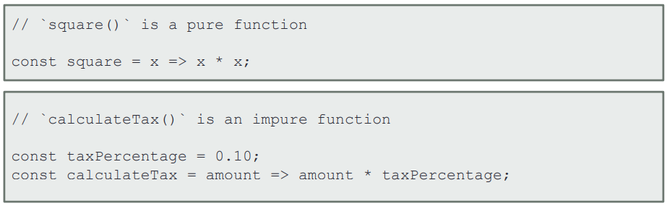
Pure Functions
sqaure() will return square value of the input and the result will always be the same.
It makes no change to the input argument and does nothing other than square the given input. square() is a pure function.
calculateTax() alters the value of the received parameter by multiplying it with taxPercentage.
calculateTax() is not pure.

Slide 17
Parts of Redux

Slide 18
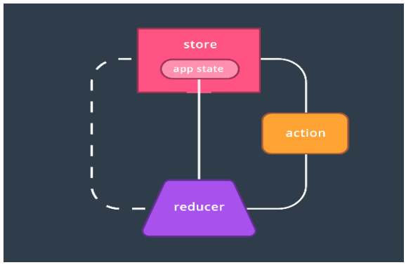
Parts of Redux
Three major parts of Redux:
Store: Is the source of truth for the state in your app
Reducers: Specify shape of state and update the store
Actions: Are payloads of information that inform reducers the types of events that have occurred in the application

Slide 19
Parts of Redux
Most of the application's data or state resides in the store.
Relationship between store, actions, and reducers:
The store's data is populated by reducers
There can be multiple reducers
An action is dispatched by the store
It is used by reducers to determine what data they should output
There can be more than one action in a Redux app

Slide 20
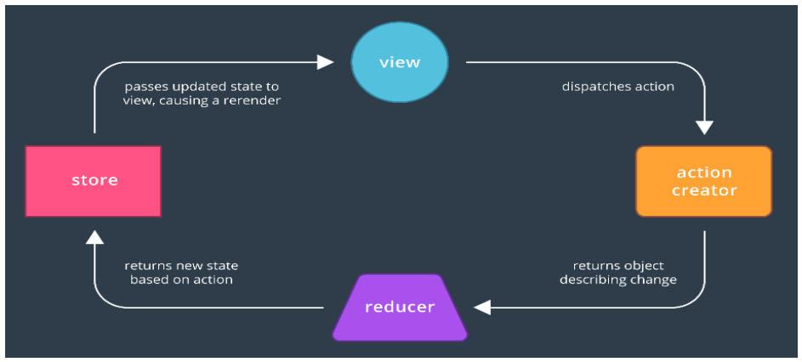
Data Flow in Redux
The store dispatches an action to its reducer.
The reducer processes the current state with the action.
It then returns the new state of the app.

Slide 21
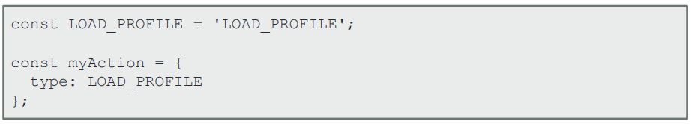
Actions
Actions are similar to browser’s native events. They are JavaScript objects that describe any event that should update the app’s state.
Properties of actions:
Can be thought of as custom events within Redux apps
Can represent various types of events or actions that occur in an app
Code below shows an action being defined
Notes:
Code shows the syntax of defining an action.

Slide 22
Actions
Action has two properties, type and payload.
Type:
It specifies the type of action that has occurred within the app.
It prefers constants rather than strings as values.
Payload:
It contains any data needed to further represent the type of action.
Payload has to be kept as small as possible.
Only necessary data should be included in payload.

Slide 23
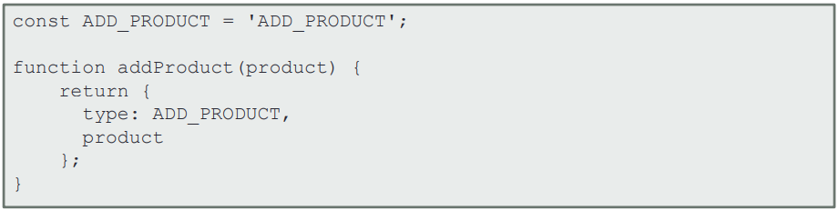
Action Creators
Action creators are JavaScript functions.
They wrap actions in functions.
They make actions more portable and easy to test.
In the code below, addProduct() is an action creator.
Whenever we need an ADD_PRODUCT action, we can just call the addProduct() function, pass it a product, and it will generate the action.

Slide 24
Reducer
Reducer is a JavaScript function that specifies shape of an application's state.
Properties of Reducer:
Receives the current state and an action that is dispatched
Decides how to transform current state into a brand new state based on the action it receives
Must be a pure function
Does not change its arguments, have side-effects or use other impure functions
Returns the new state of the application
Notes:
• You need to make sure you always return either the new state or the previous state
• The way you decide how to change the state is based on the type of action that
was dispatched
Store your state in Redux if two Components rely on the same piece of state, or if
the operation to get that state was expensive.

Slide 25
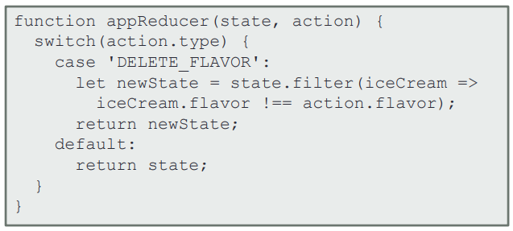
Reducer
In the code below, the function appReducer() is a reducer which takes state and action as arguments and changes the state based on the action.

Slide 26
Store
The store holds the whole state tree of the application.
It dispatches actions.
It invokes reducers.
It receives and stores new state.
It has the following methods:
getStore(): It returns the current state object tree.
dispatch(): It dispatches an action to change the state.
subscribe(): It listens to changes in the state tree.
replaceReducer(): It replaces the current reducer with another.

Slide 27
Installing Redux

Slide 28
Installing Redux Package
Run the command below to install Redux.
npm install --save redux

Slide 30
Which of the following is a property of Redux?
1
Redux was inspired by the MVC architecture
Redux is a heavyweight library which offers a lot of functionality to manage state in an app
Redux keeps the state of your application in a store
Redux uses impure functions to make changes to state

Slide 31
Which of the following is a property of Redux?
1
Redux was inspired by the MVC architecture
Redux is a heavyweight library which offers a lot of functionality to manage state in an app
Redux keeps the state of your application in a store
Redux uses impure functions to make changes to state
c
Redux uses a store as a single source of truth where the state of the whole application is stored in an object tree.
Notes:
Redux was inspired by the Flux architecture.
Redux is a lightweight library with limited functionality.
Redux uses pure functions to make changes to state.

Slide 32
Which of the following is a pure function?
2
A function that returns void
A function that returns the same result for the same input
A function that has side effects like net­work or data­base calls
A function that updates the arguments it receives

Slide 33
Which of the following is a pure function?
2
A function that returns void
A function that returns the same result for the same input
A function that has side effects like net­work or data­base calls
A function that updates the arguments it receives
b
Pure functions are functions that always return the same output for the same input arguments.
Notes:
Pure functions do not have any side effects and never makes any changes to the passed in parameters.

Slide 34
Which of the following is true about reducers?
3
Reducers are idempotent functions
Reducers take the current state of a Component and return a feasible action
Reducer is called a reducer because it's the type of function you would pass to Array.prototype.reduce()
Reducers are static functions

Slide 35
Which of the following is true about reducers?
3
Reducers are idempotent functions
Reducers take the current state of a Component and return a feasible action
Reducer is called a reducer because it's the type of function you would pass to Array.prototype.reduce()
Reducers are static functions
c
A reducer is called a reducer because it's the type of function you would pass to Array.prototype.reduce(reducer, ?initialValue).
Notes:
The reducer is a pure function that takes the previous state and an action, and returns the next state.

Slide 36
Redux is a popular state management tool.
Redux makes it easy to manage shared state.
Redux has a single source of truth.
Redux has three major parts: store, action, and reducer.

